Slide 1
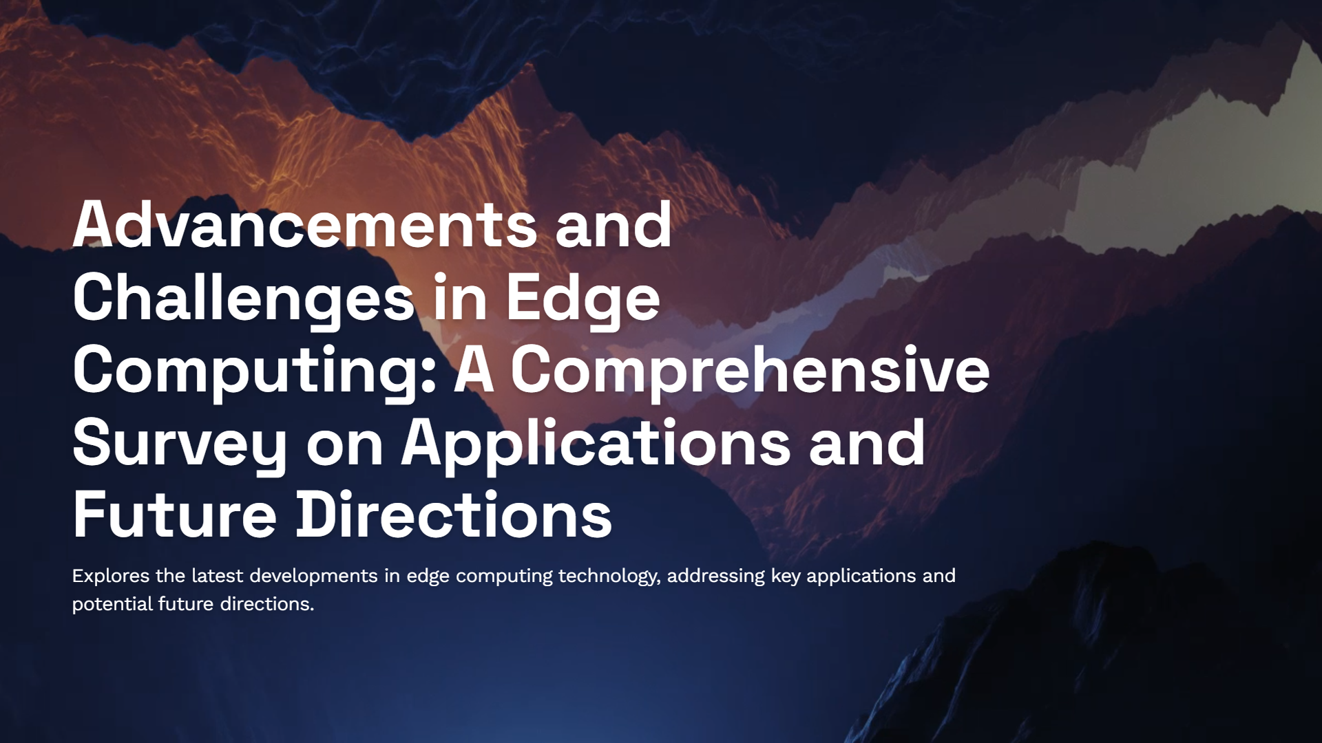
Exploring Diverse Perspective on Edge Computing

Slide 2
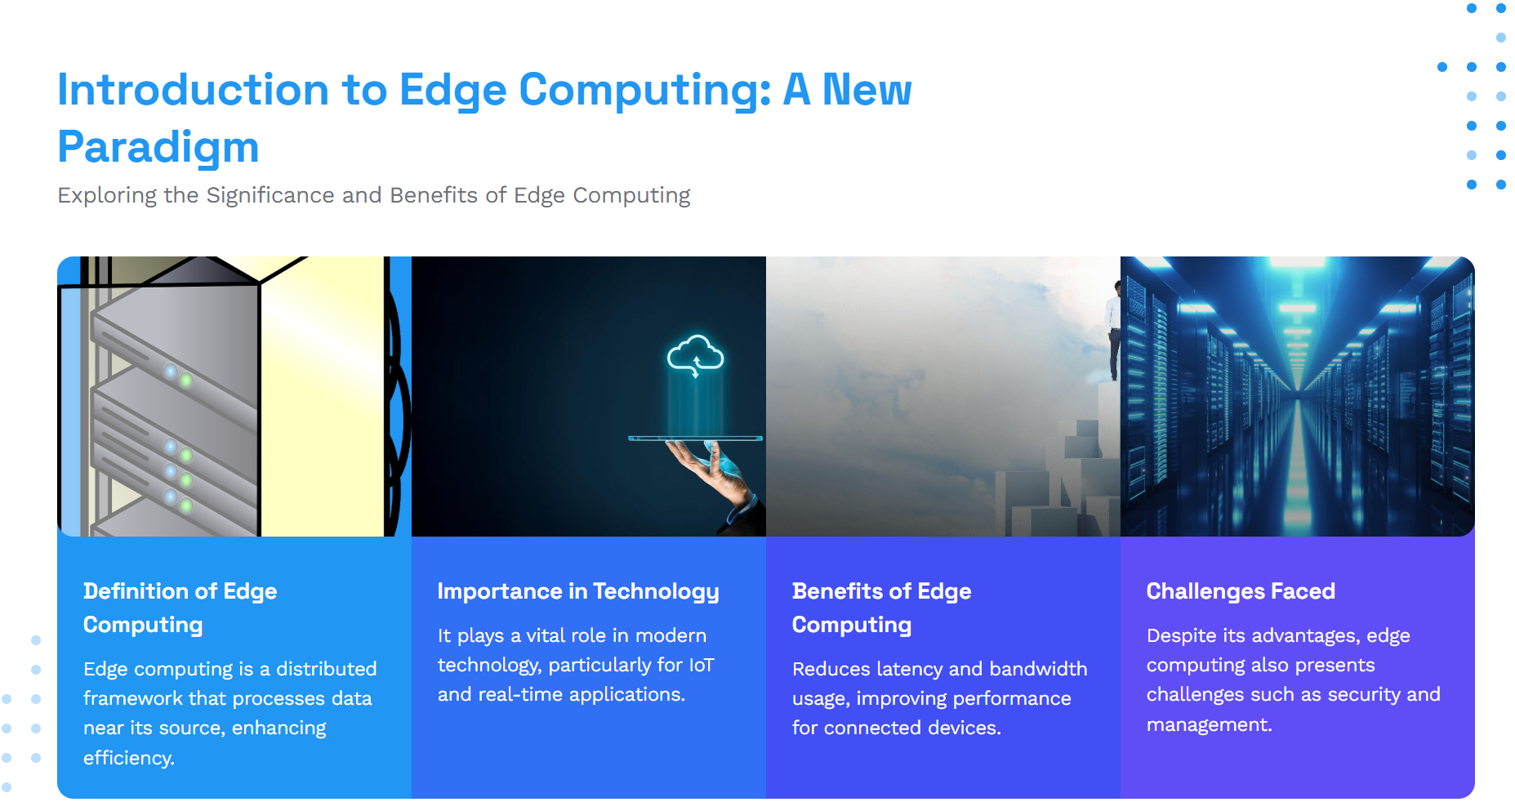

Slide 3
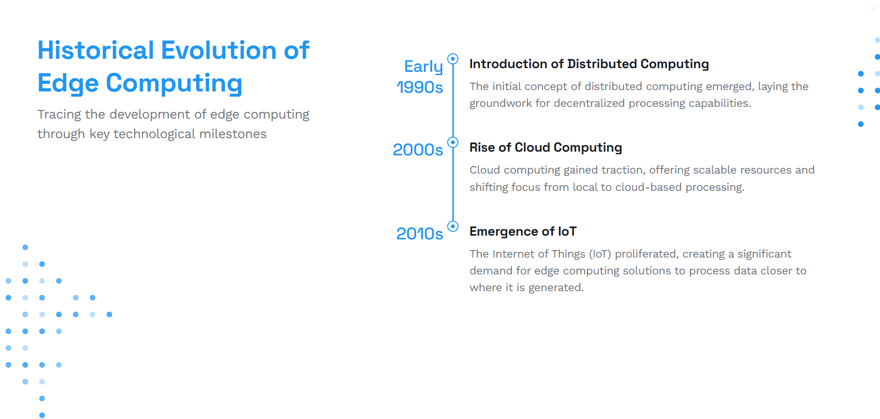
Year | Milestone Description
1990s | Emergence of Content Delivery Networks (CDNs)
2000s | Proliferation of mobile computing and Internet of Things (IoT)
2010s | Introduction of fog computing
2017 | Release of the Open Fog reference architecture
2020s | Integration of 5G networks with edge computing

Slide 4
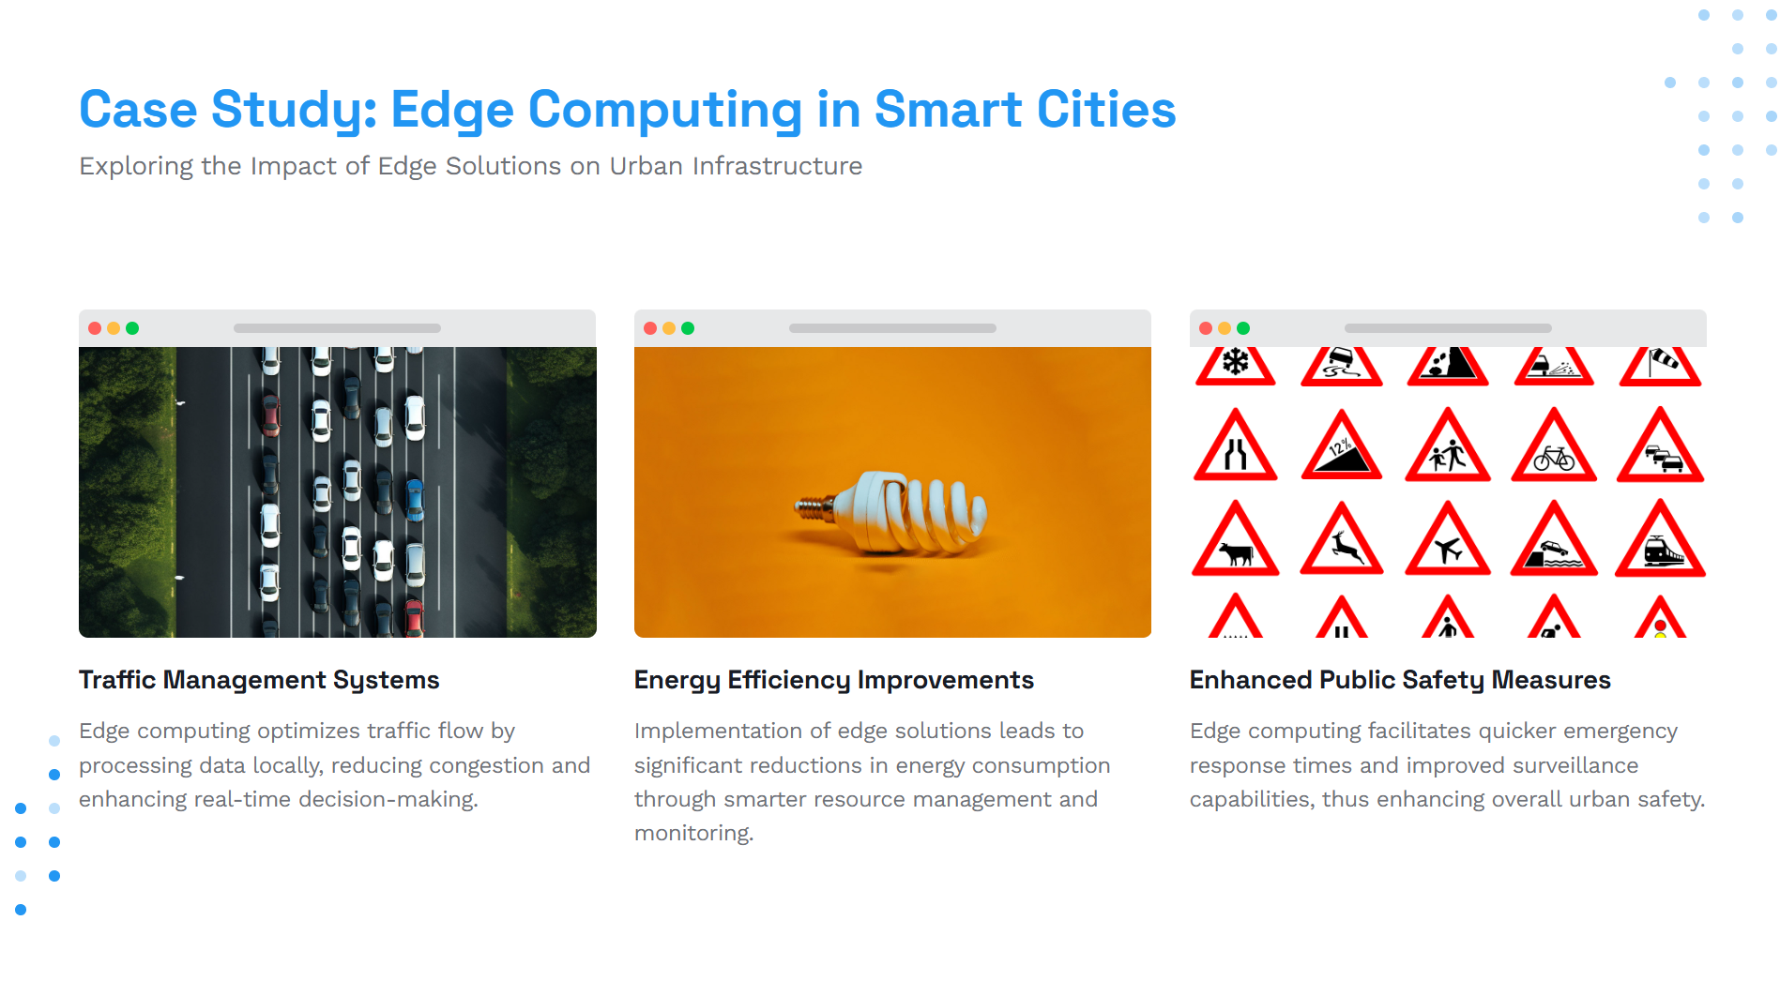

Slide 5
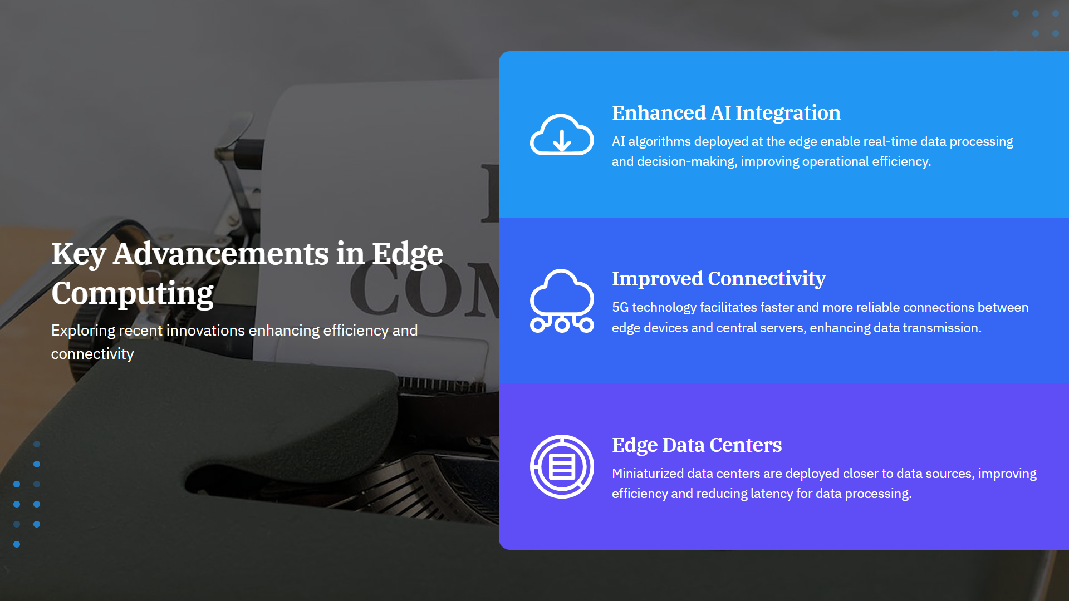

Slide 6
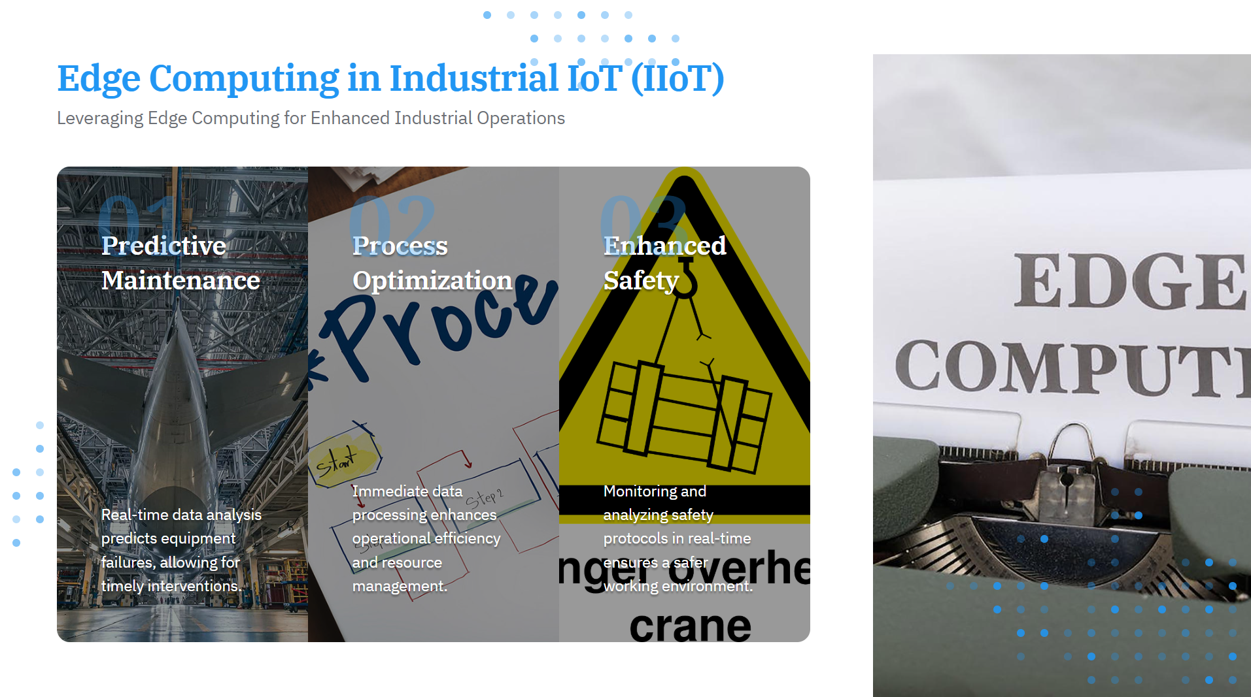

Slide 7
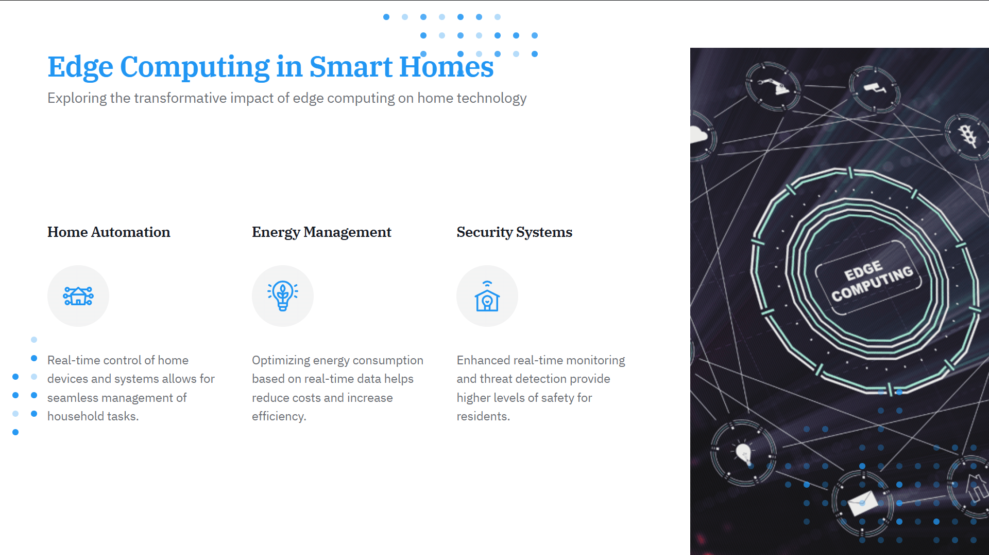

Slide 8
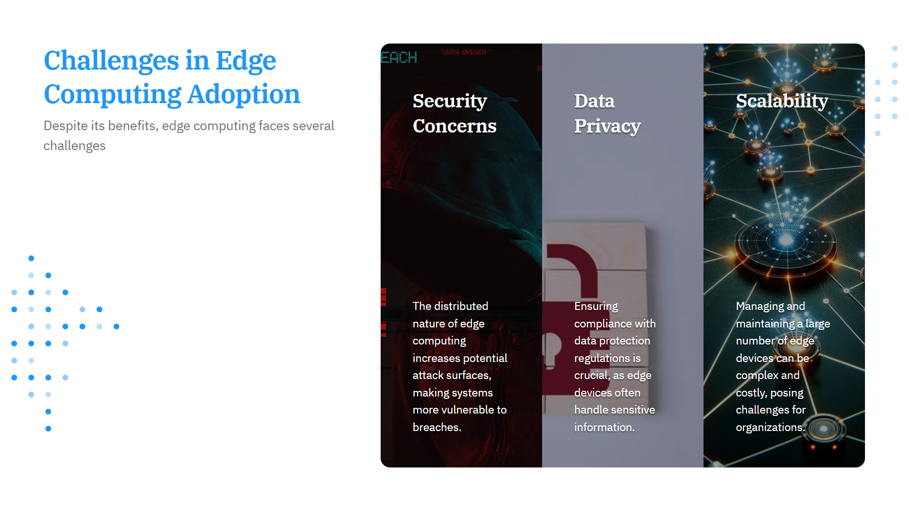

Slide 9
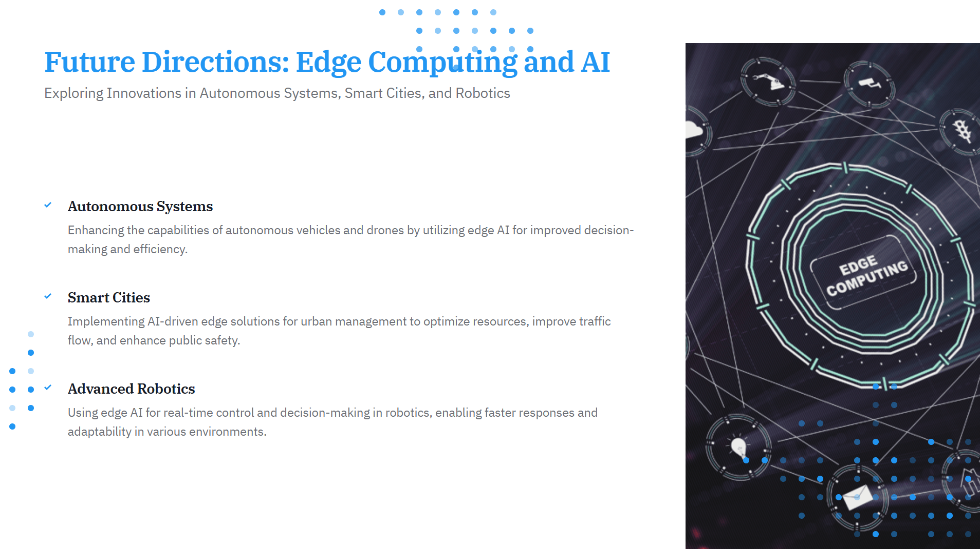

Slide 10
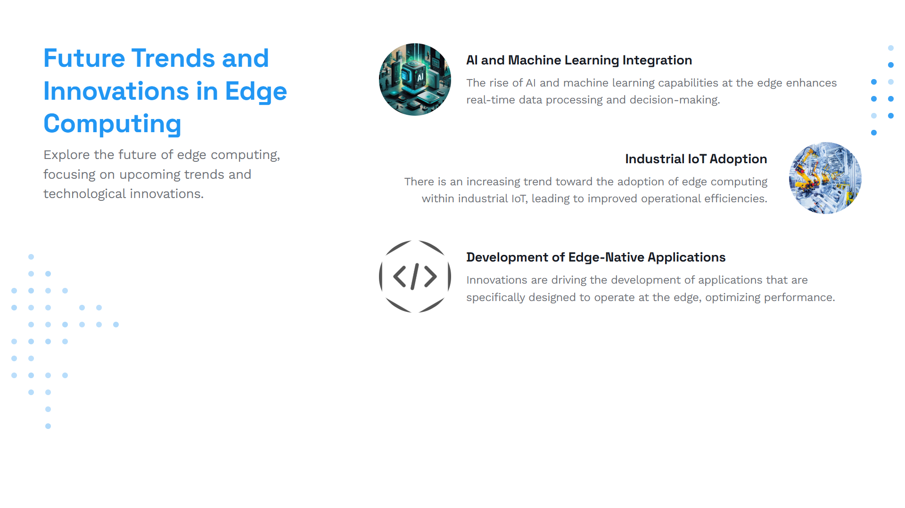

Slide 11
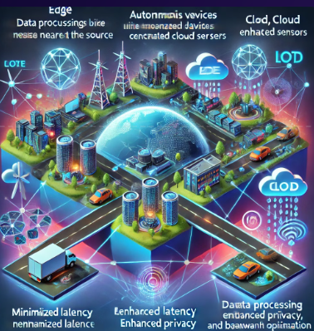
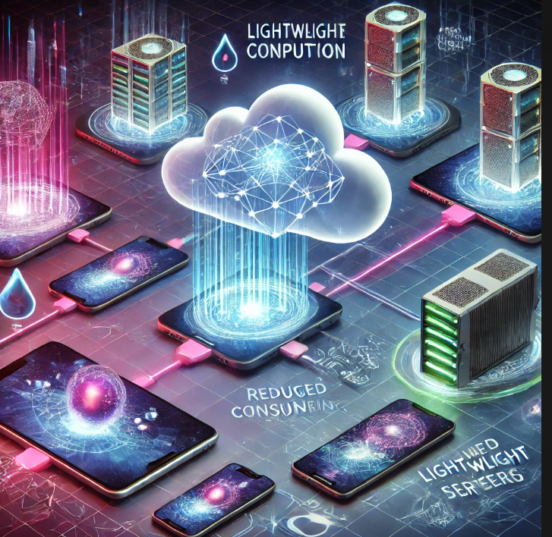
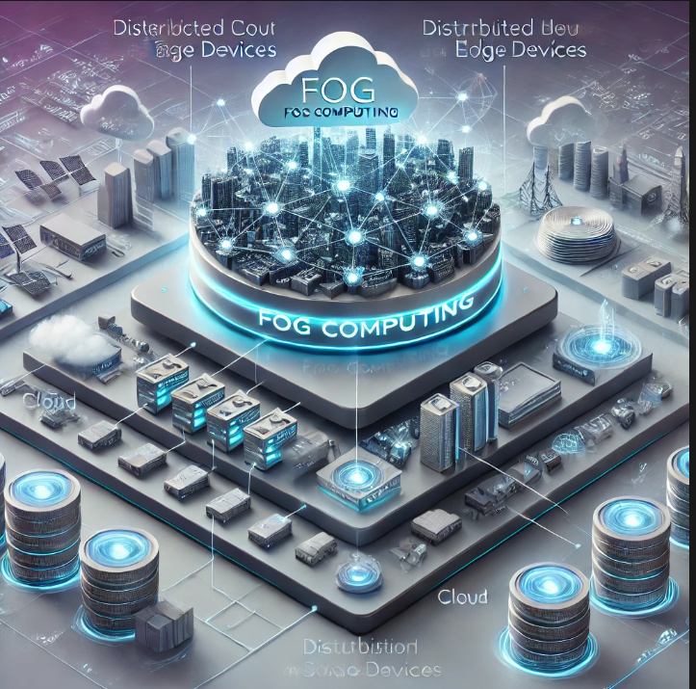
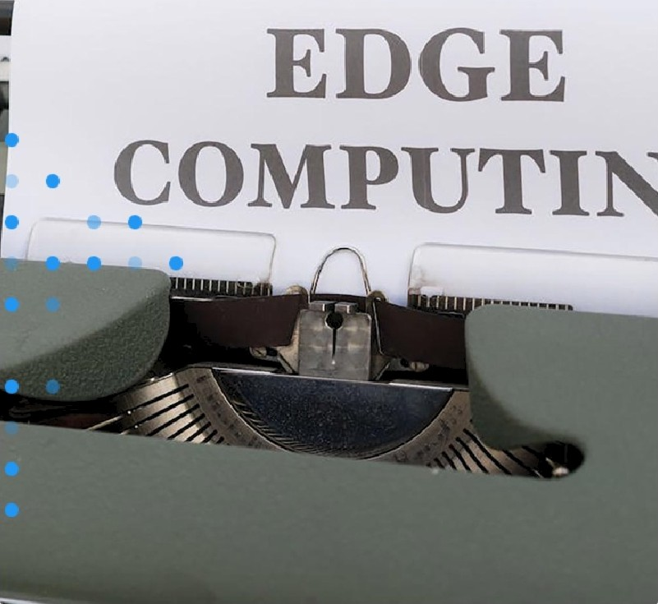
Edge Computing and other Technologies
.
Exploring Other technologies with Edge
”
Edge Computing and Cloud System
Cloudlet Computing
Fog Computing
Edge computing complements cloud systems by decentralizing computational tasks and
processing data closer to the source, reducing the load on centralized cloud servers
Lightweight and scalable computing infrastructure located near mobile devices. Offloads tasks from resource-constrained devices (e.g., smartphones)
Fog computing extends edge computing hierarchically, serving as an intermediary between edge devices and cloud systems. It manages large-scale IoT deployments, distributing
computational

Slide 12
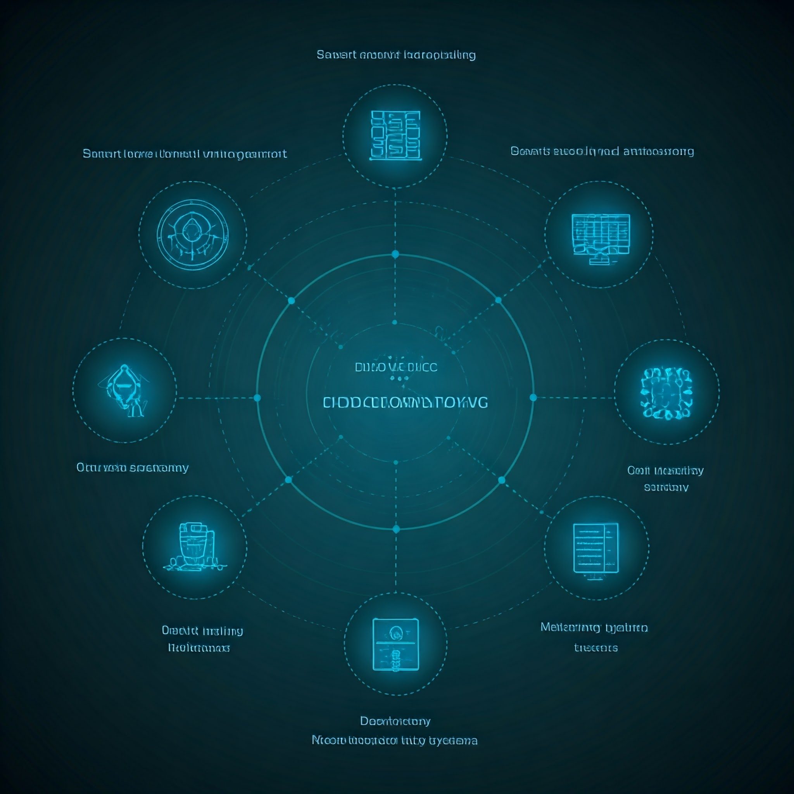

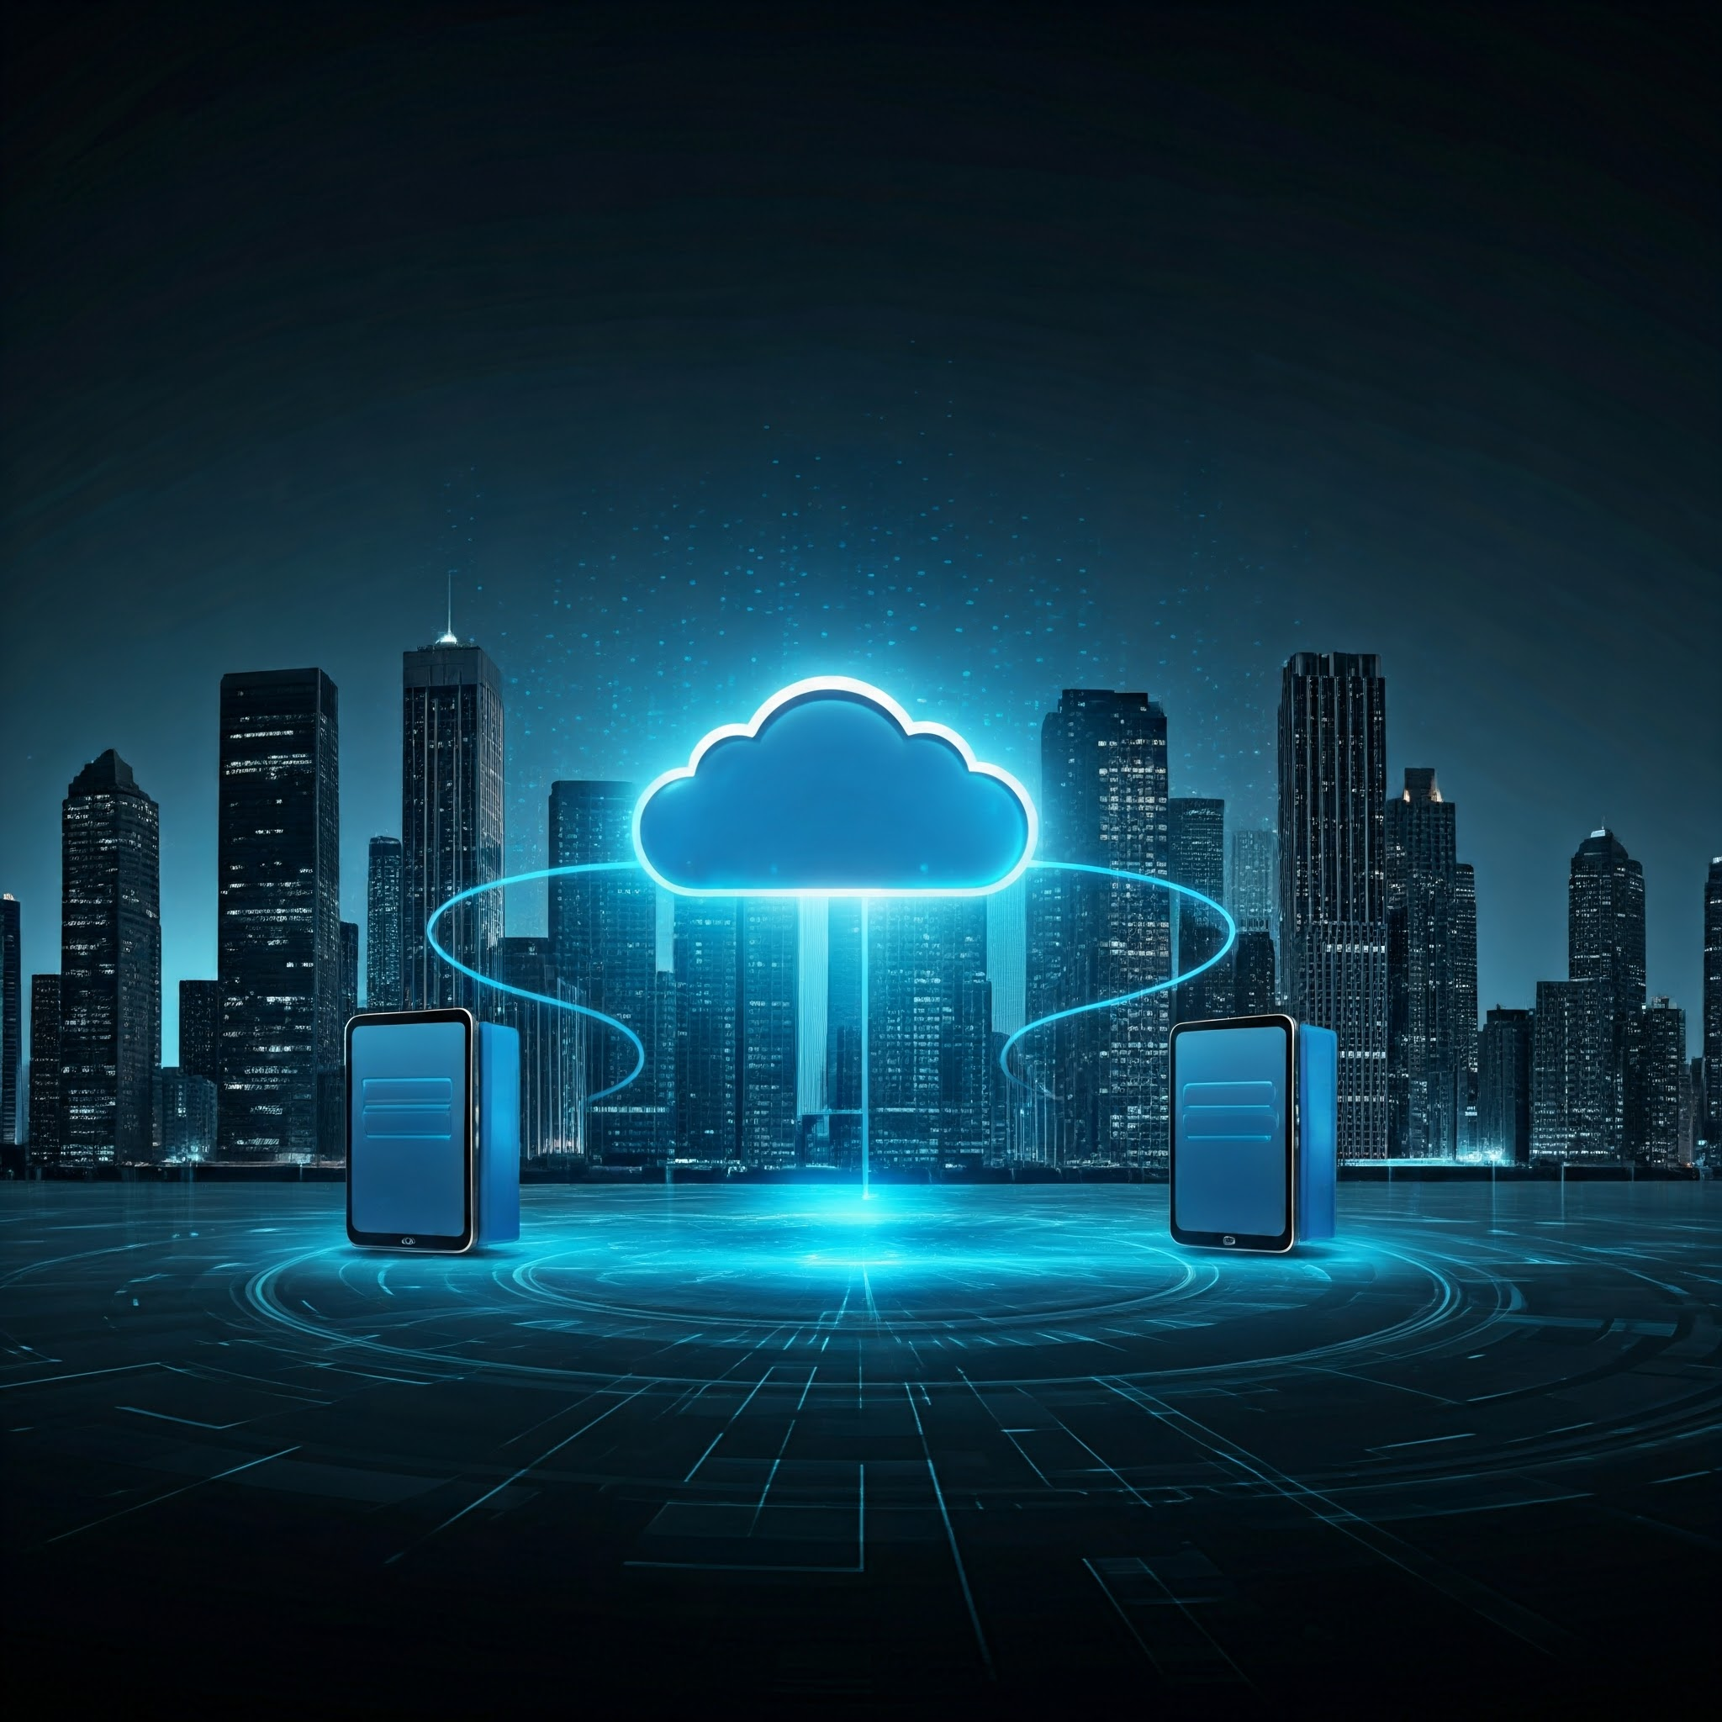
Views from Leading Authors: A Comparative Analysis
" " " I
Edge computing has been widely discussed in research due to its significant benefits for real-time data processing and integration with emerging technologies. Here are insights from various authors and their contributions to the understanding of edge computing:
Shiyang Liang et al. (2024)
Their review emphasizes edge computing as a transformative approach that minimizes data transmission distances, enhancing real-time processing capabilities. They highlight its applications in power systems, such as smart meter management and data analysis, showcasing how edge computing supports grid reliability and security by reducing latency and increasing efficiency in monitoring systems
Authors from MDPI's Review (2023)
This review outlines the duality of edge computing and cloud computing, particularly in IoT ecosystems. The authors compare their strengths, noting that while cloud computing offers scalability and extensive resources, edge computing addresses latency-sensitive tasks and improves privacy by processing data closer to the source.
Satyanarayanan et al. (2017)
These authors are path-finders in conceptualizing edge computing frameworks. They underscore the role of "Cloudlets" in bringing computational resources closer to mobile devices, enabling applications like augmented reality and video analytics by minimizing latency and dependency on centralized servers​

Slide 13
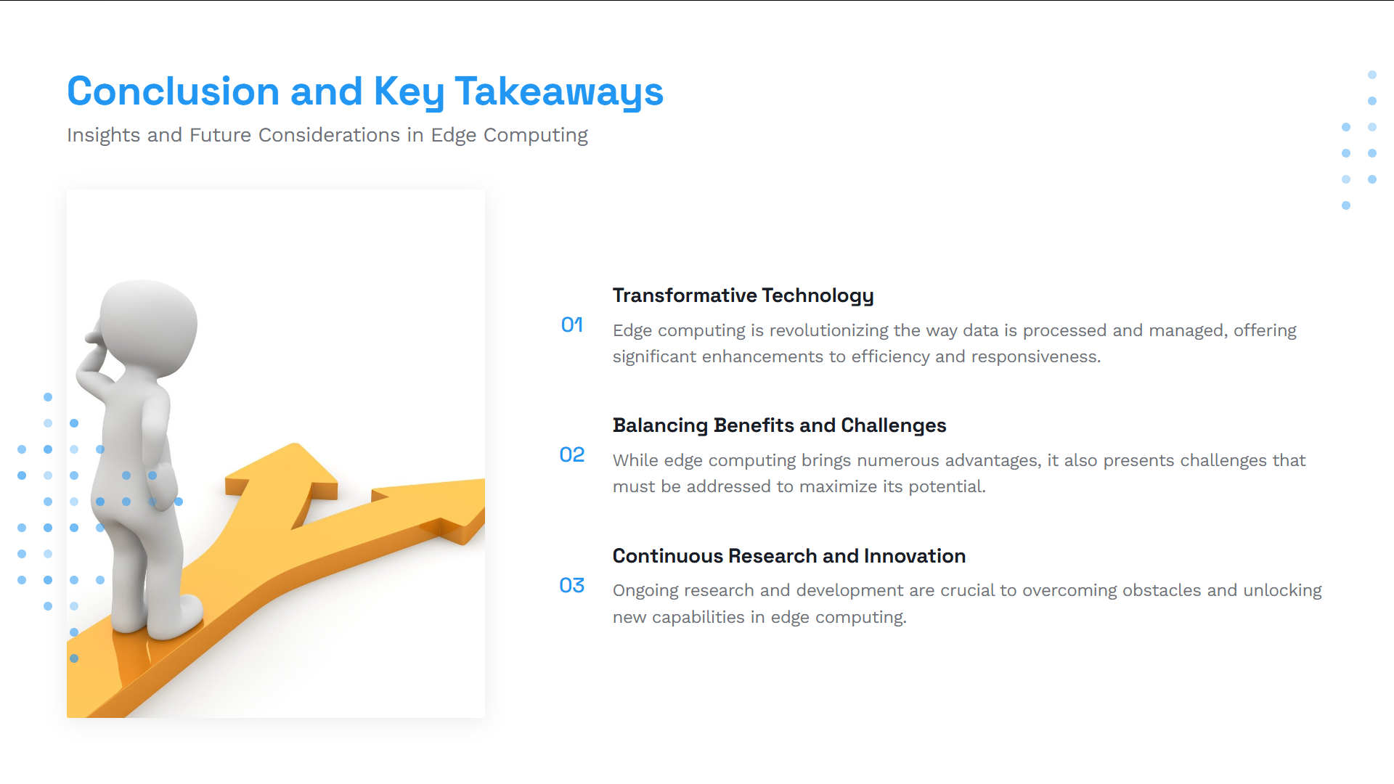

Slide 14
References
A Review of Edge Computing Technology and Its Applications in Power Systems. 30 May 2024 / Revised: 19 June 2024 / Accepted: 21 June 2024 / Published: 1 July 2024
Edge Computing and Cloud Computing for Internet of Things: A Review. 16 July 2024 / Revised: 16 September 2024 / Accepted: 24 September 2024 / Published: 30 September 2024.
M. Satyanarayanan, "The Emergence of Edge Computing," in Computer, vol. 50, no. 1, pp. 30-39, Jan. 2017, doi: 10.1109/MC.2017.9.

